Slide 1



DM2124 Assn2 GROUP 2
Foo Jing Ting (152856H)
Wong Keng Han Ashley (155135S)
Seah Jun Hao Reynard (153674K)
Sri Sham Haran (155129R)

Slide 2



Cloud storage
Company Goal:
Develop free-to-play games to top the charts of the Google Play and AppStore
Build Wars(Ashley)
Casual Sandbox & Strategy game for iOS and Android devices. For people aged 16 – 23.
Agent Vs Agent(Sham)
Action game for iOS and Android devices. For people aged 10-18.
Magic S-Ward(Jing Ting)
Action Role-Playing Game (RPG) for iOS and Android devices. For people aged 14-22.
Five in Line(Reynard)
Turn-based Strategy game for iOS and Android devices. For people of all ages..

Slide 3
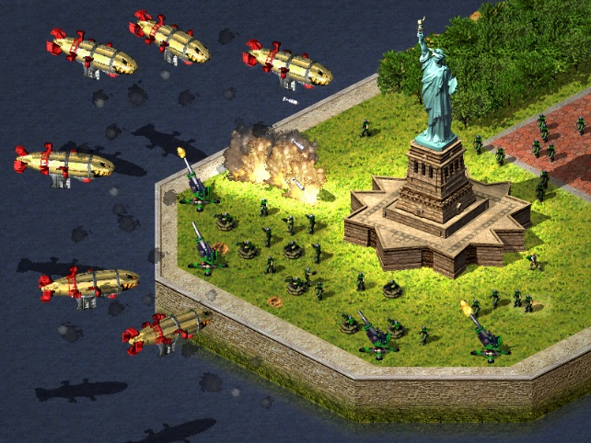
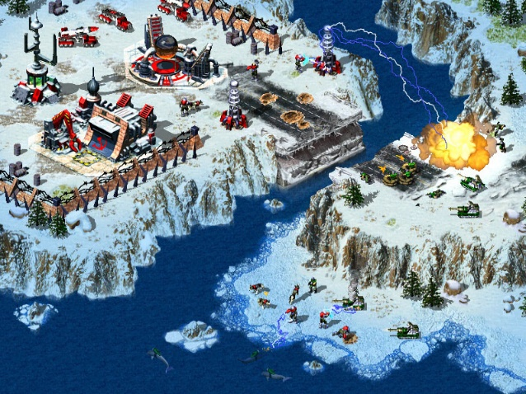
GAME OF FOCUS Build Wars
Build Wars
Shows potential to do well in the charts.
Good appeal; Mobile game market lacks games of this genre that are of good quality.
Easy to expand the game with sequels.
Potential franchise with good following.
Mock-Up of Build Wars

Slide 4
Work Plan
Working hours: 9am – 5pm; Weekdays only
30 minutes set aside for discussions with team to establish needs that are to be met
Sprints! Iterations last 2 weeks.
Daily scrums.
Base Game
Multiplayer/ Online support
Micro-transactions / store & prep for alpha release
Bug Fixing Add features based on feedback
Pre-Registration Prep
Publicity Bug Fixing
Final Release

Slide 5


TEAM EFFICIENCY
EFFECTIVE COMMUNICATION == TEAM EFFICIENCY
Effective communication
Take daily meetings seriously.
Be social & positive
Use communication platforms such as e-mail, Whatsapp, Slack and Discord to communicate with team members
Respect & loyalty
Establish Trust
Stay loyal to managers and department leaders
Mutual Respect
Dissemination of information from project manager & department leaders
Practice efficient collaboration & sharing of information

Slide 6







System Preparation What DO we Use?
Microsoft Visual Studio
AutoDesk Maya
Adobe Photoshop
GitHub & SmartGit
Trello & teamwork.com

Slide 7



Risk management
Backup your work
Do not rely on online methods only
Work to avoid file collaboration conflicts
Be prepared to move around in the event that we have to go offline
Maintain mutual respect and avoid conflict with team members
If we are falling behind schedule, expect to be informed to delay features & extra gamemodes that are not crucial till post-release

Slide 8
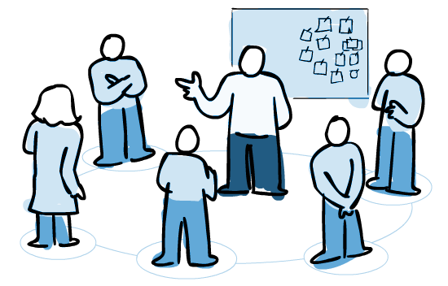

Agile Management Plan
Scrum
Daily Scrum meeting every day.
Sprints that last 2 weeks each.
Having Sprint reviews before each sprint.
Testing before implementing.
Sprint backlogs.
2 Weeks

Slide 9
End Of Presentation
Q & A
Thank You!

